Slide 1
Semantic Tableaux Method
It was proposed as a proof method for classical logics by
R. Smullyan in 1968.
Dedicated theorem provers: 3TAP, pTAP, leanTAP, Cassandra.
It was easily adapted to nonstandard logics (modal, temporal, many-valued, non-monotonic).
It is based on semantic considerations => semantic method.
Its basic aim is to decide consistency and to find all the models of a formula by decomposing the formula in subformulas.
The validity of a formula is proved by contradiction=>
=> refutation method.
1

Slide 2
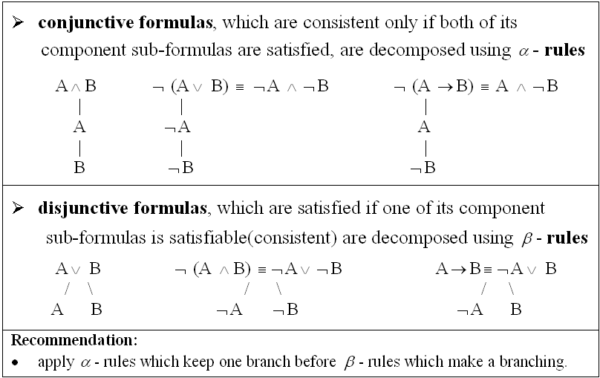
Decomposition rules for propositional formulas

Slide 3
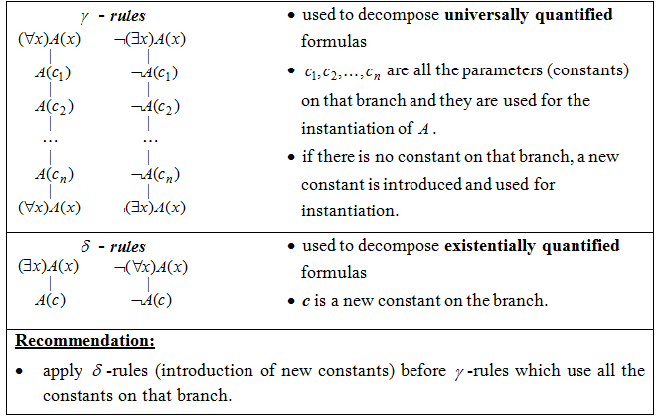
Decomposition rules for predicate formulas

Slide 4
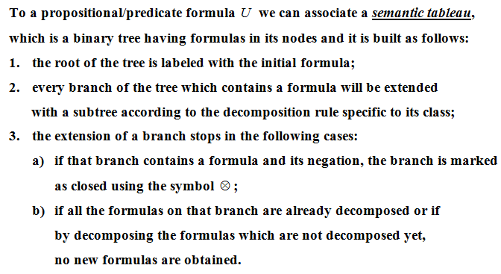
Construction of a semantic tableau

Slide 5
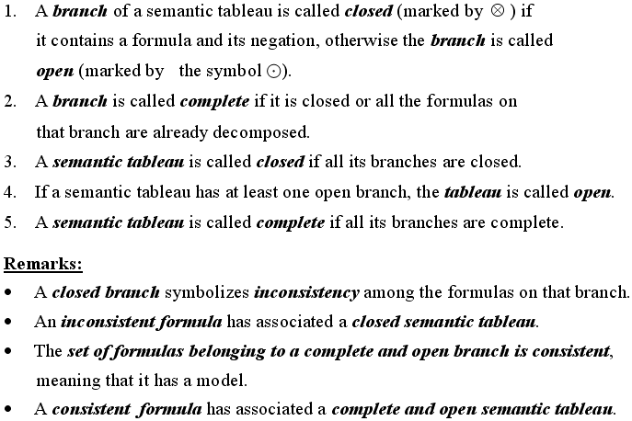
Definitions

Slide 6
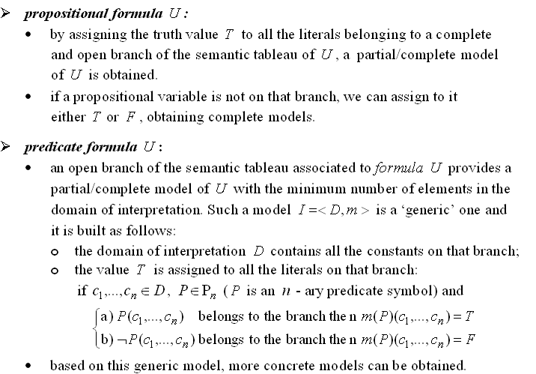
Models of a formula

Slide 7
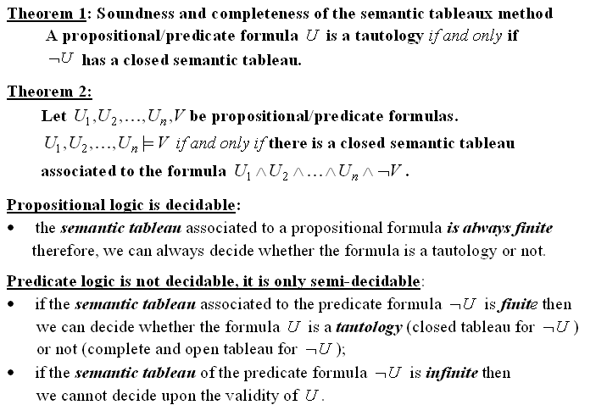
Theorems
Semantic tableaux method – a refutation proof method

Slide 8
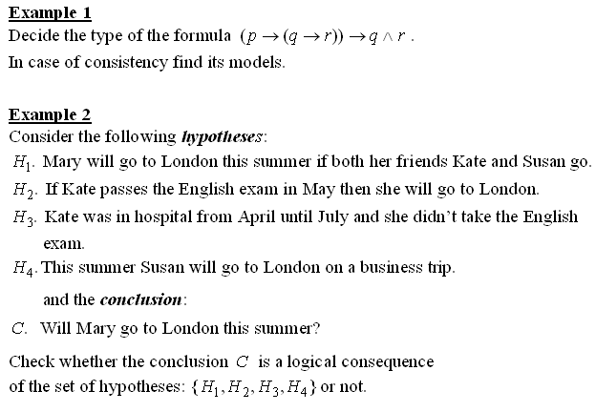
Examples (solved during lecture)

Slide 9
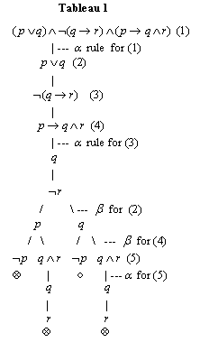
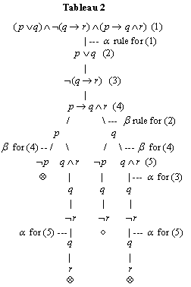
Example 3. Build two different semantic tableaux for the formula:

Slide 10
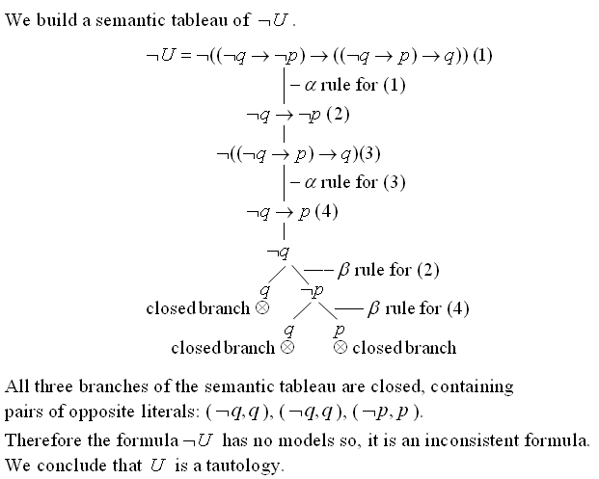
Example 4.
Prove the validity of

Slide 11
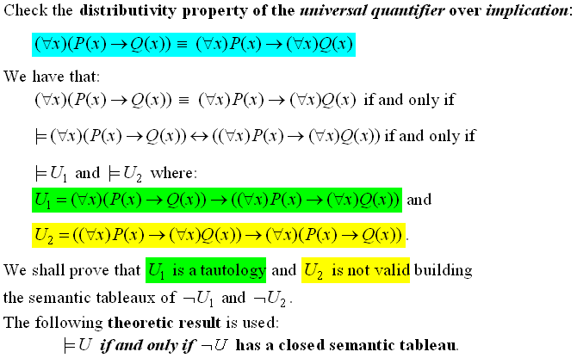
Example 5:

Slide 12

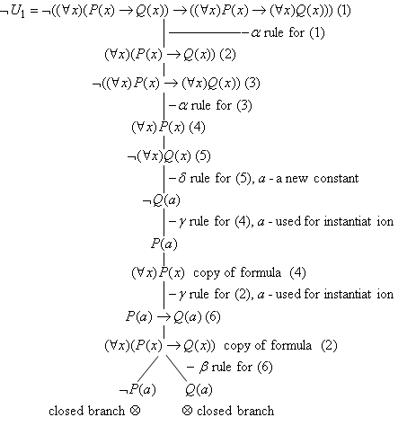

Slide 13

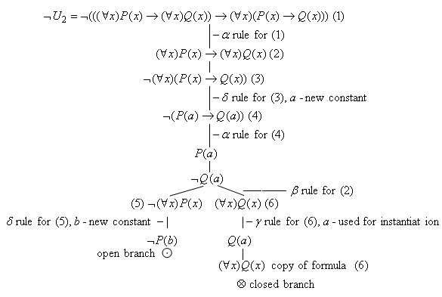

Slide 14

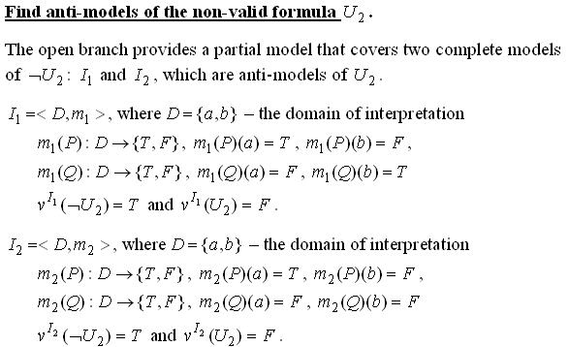

Slide 15
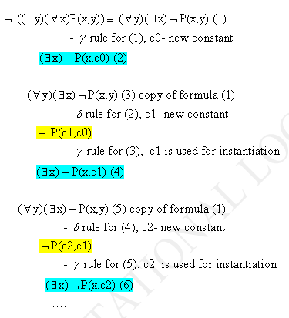
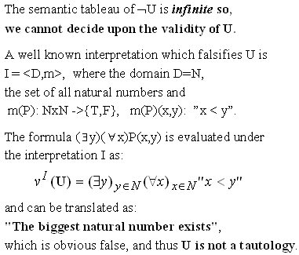
Example 6: Prove the non-validity of

